Slide 1

Mining Data Streams (Part 2)
Note to other teachers and users of these slides: We would be delighted if you found this our material useful in giving your own lectures. Feel free to use these slides verbatim, or to modify them to fit your own needs. If you make use of a significant portion of these slides in your own lecture, please include this message, or a link to our web site: http://www.mmds.org
Mining of Massive Datasets
Jure Leskovec, Anand Rajaraman, Jeff Ullman Stanford University
http://www.mmds.org

Slide 2
Today’s Lecture
More algorithms for streams:
(1) Filtering a data stream: Bloom filters
Select elements with property x from stream
(2) Counting distinct elements: Flajolet-Martin
Number of distinct elements in the last k elements of the stream
(3) Estimating moments: AMS method
Estimate std. dev. of last k elements
(4) Counting frequent items

Slide 3
(1) Filtering Data Streams

Slide 4
Filtering Data Streams
Each element of data stream is a tuple
Given a list of keys S
Determine which tuples of stream are in S
Obvious solution: Hash table
But suppose we do not have enough memory to store all of S in a hash table
E.g., we might be processing millions of filters on the same stream

Slide 5
Applications
Example: Email spam filtering
We know 1 billion “good” email addresses
If an email comes from one of these, it is NOT spam
Publish-subscribe systems
You are collecting lots of messages (news articles)
People express interest in certain sets of keywords
Determine whether each message matches user’s interest

Slide 6
First Cut Solution (1)
Given a set of keys S that we want to filter
Create a bit array B of n bits, initially all 0s
Choose a hash function h with range [0,n)
Hash each member of s∈ S to one of n buckets, and set that bit to 1, i.e., B[h(s)]=1
Hash each element a of the stream and output only those that hash to bit that was set to 1
Output a if B[h(a)] == 1

Slide 7
First Cut Solution (2)
Output the item since it may be in S.
Item hashes to a bucket that at least one of the items in S hashed to.
Filter
Item
Hash func h
0010001011000
Bit array B
Drop the item.
It hashes to a bucket set to 0 so it is surely not in S.
Creates false positives but no false negatives
If the item is in S we surely output it, if not we may still output it

Slide 8
First Cut Solution (3)
|S| = 1 billion email addresses |B|= 1GB = 8 billion bits
If the email address is in S, then it surely hashes to a bucket that has the bit set to 1, so it always gets through (no false negatives)
Approximately 1/8 of the bits are set to 1, so about 1/8th of the addresses not in S get through to the output (false positives)
Actually, less than 1/8th, because more than one address might hash to the same bit

Slide 9
Analysis: Throwing Darts (1)
More accurate analysis for the number of false positives
Consider: If we throw m darts into n equally likely targets, what is the probability that a target gets at least one dart?
In our case:
Targets = bits/buckets
Darts = hash values of items

Slide 10
Analysis: Throwing Darts (2)
We have m darts, n targets
What is the probability that a target gets at least one dart?
Equals 1/e
as n →∞
Equivalent
n(
m
/ n)
1 -
(1 – 1/n)
1 – e^{–m/n}
Probability some
target X not hit
by a dart
Probability at
least one dart
hits target X

Slide 11
Analysis: Throwing Darts (3)
Fraction of 1s in the array B = = probability of false positive = 1 – e^{-m/n}
Example: 10⁹ darts, 8∙10⁹ targets
Fraction of 1s in B = 1 – e^{-1/8} = 0.1175
Compare with our earlier estimate: 1/8 = 0.125

Slide 12
Bloom Filter
Consider: |S| = m, |B| = n
Use k independent hash functions h₁ ,…, h_{k}
Initialization:
Set B to all 0s
Hash each element s∈ S using each hash function h_{i}, set B[h_{i}(s)] = 1 (for each i = 1,.., k)
Run-time:
When a stream element with key x arrives
If B[h_{i}(x)] = 1 for all i = 1,..., k then declare that x is in S
That is, x hashes to a bucket set to 1 for every hash function h_{i}(x)
Otherwise discard the element x
(note: we have a single array B!)

Slide 13
Bloom Filter -- Analysis
What fraction of the bit vector B are 1s?
Throwing k∙m darts at n targets
So fraction of 1s is (1 – e^{-km/n})
But we have k independent hash functions and we only let the element x through if all k hash element x to a bucket of value 1
So, false positive probability = (1 – e^{-km/n})^{k}

Slide 14
Bloom Filter – Analysis (2)
m = 1 billion, n = 8 billion
k = 1: (1 – e^{-1/8}) = 0.1175
k = 2: (1 – e^{-1/4})² = 0.0493
What happens as we keep increasing k?
“Optimal” value of k: n/m ln(2)
In our case: Optimal k = 8 ln(2) = 5.54 ≈ 6
Error at k = 6: (1 – e^{-1/6})² = 0.0235
False positive prob.
Number of hash functions, k

Slide 15
Bloom Filter: Wrap-up
Bloom filters guarantee no false negatives, and use limited memory
Great for pre-processing before more expensive checks
Suitable for hardware implementation
Hash function computations can be parallelized
Is it better to have 1 big B or k small Bs?
It is the same: (1 – e^{-km/n})^{k} vs. (1 – e^{-m/(n/k)})^{k}
But keeping 1 big B is simpler

Slide 16
(2) Counting Distinct Elements

Slide 17
Counting Distinct Elements
Problem:
Data stream consists of a universe of elements chosen from a set of size N
Maintain a count of the number of distinct elements seen so far
Obvious approach: Maintain the set of elements seen so far
That is, keep a hash table of all the distinct elements seen so far

Slide 18
Applications
How many different words are found among the Web pages being crawled at a site?
Unusually low or high numbers could indicate artificial pages (spam?)
How many different Web pages does each customer request in a week?
How many distinct products have we sold in the last week?

Slide 19
Using Small Storage
Real problem: What if we do not have space to maintain the set of elements seen so far?
Estimate the count in an unbiased way
Accept that the count may have a little error, but limit the probability that the error is large

Slide 20
Flajolet-Martin Approach
Pick a hash function h that maps each of the N elements to at least log₂ N bits
For each stream element a, let r(a) be the number of trailing 0s in h(a)
r(a) = position of first 1 counting from the right
E.g., say h(a) = 12, then 12 is 1100 in binary, so r(a) = 2
Record R = the maximum r(a) seen
R = max_{a} r(a), over all the items a seen so far
Estimated number of distinct elements = 2^{R}

Slide 21
Why It Works: Intuition
Very very rough and heuristic intuition why Flajolet-Martin works:
h(a) hashes a with equal prob. to any of N values
Then h(a) is a sequence of log₂ N bits, where 2^{-r} fraction of all as have a tail of r zeros
About 50% of as hash to ***0
About 25% of as hash to **00
So, if we saw the longest tail of r=2 (i.e., item hash ending *100) then we have probably seen about 4 distinct items so far
So, it takes to hash about 2^{r} items before we see one with zero-suffix of length r

Slide 22
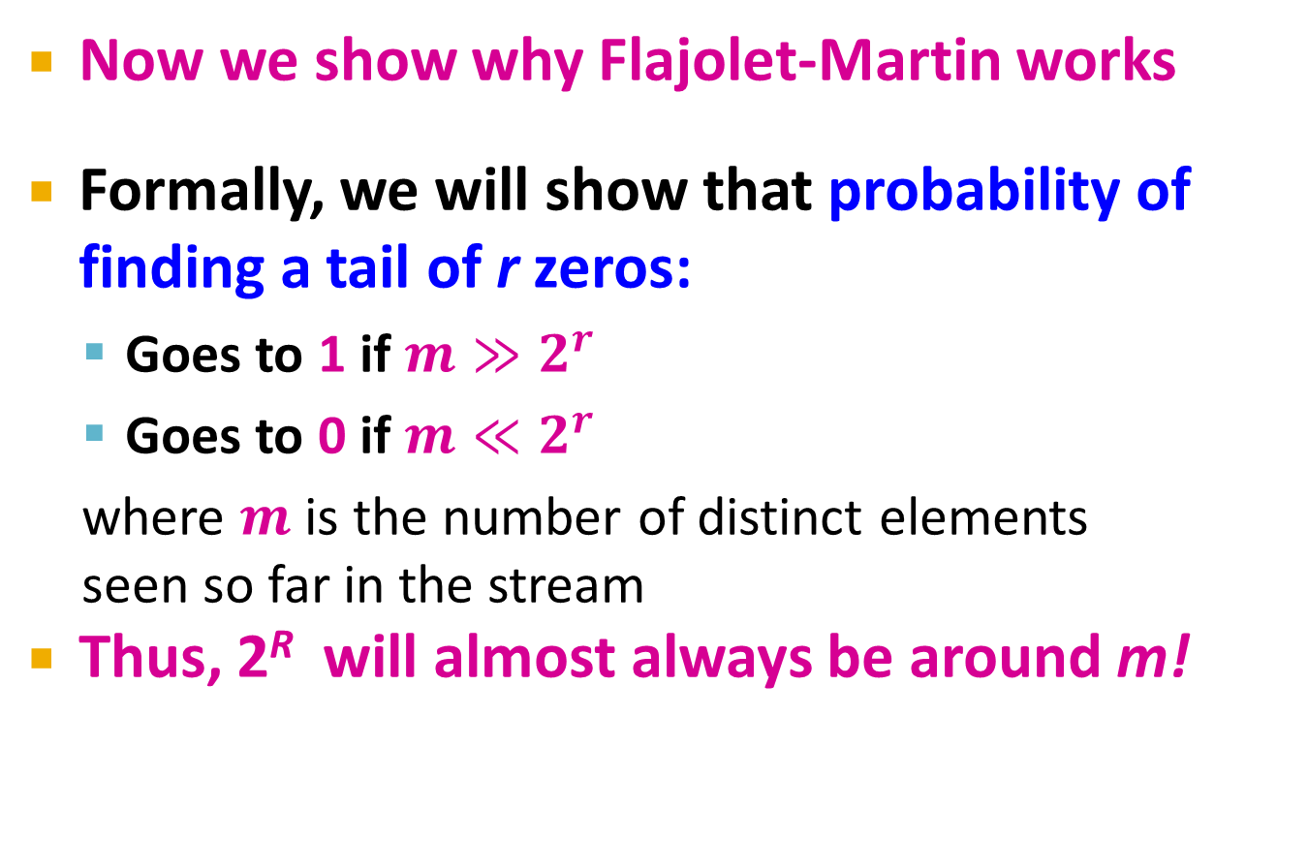
Why It Works: More formally
Now we show why Flajolet-Martin works
Formally, we will show that probability of finding a tail of r zeros:
Goes to 1 if $m≫2^{r}$
Goes to 0 if $m≪2^{r}$
where $m$ is the number of distinct elements seen so far in the stream
Thus, 2^{R} will almost always be around m!

Slide 23
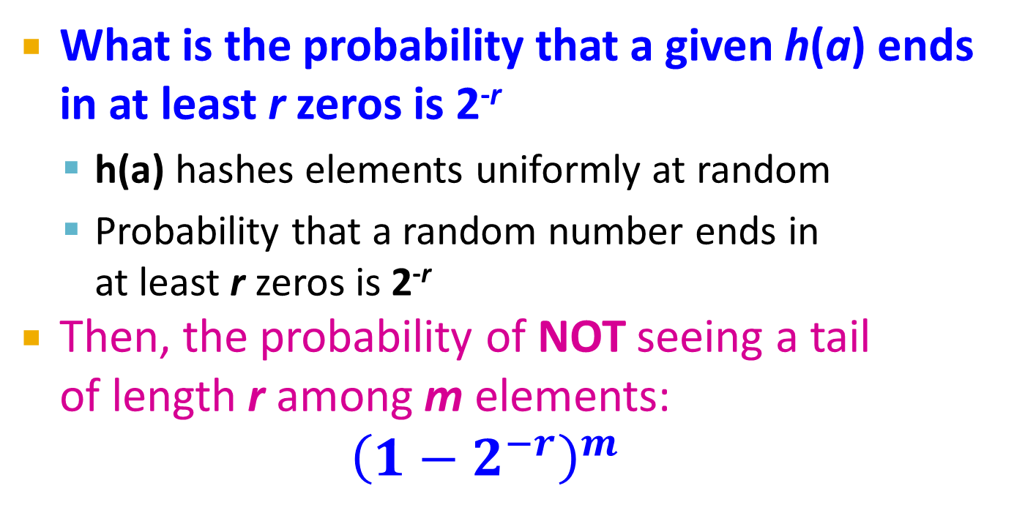
Why It Works: More formally
What is the probability that a given h(a) ends in at least r zeros is 2^{-r}
h(a) hashes elements uniformly at random
Probability that a random number ends in at least r zeros is 2^{-r}
Then, the probability of NOT seeing a tail of length r among m elements:
$${\left(1−2^{−r}\right)}^{m}$$
Prob. all end in fewer than r zeros.
Prob. that given h(a) ends in fewer than r zeros

Slide 24
Why It Works: More formally
Note:
Prob. of NOT finding a tail of length r is:
If m << 2^{r}, then prob. tends to 1
as m/2^{r}→ 0
So, the probability of finding a tail of length r tends to 0
If m >> 2^{r}, then prob. tends to 0
as m/2^{r} → ∞
So, the probability of finding a tail of length r tends to 1
Thus, 2^{R} will almost always be around m!

Slide 25
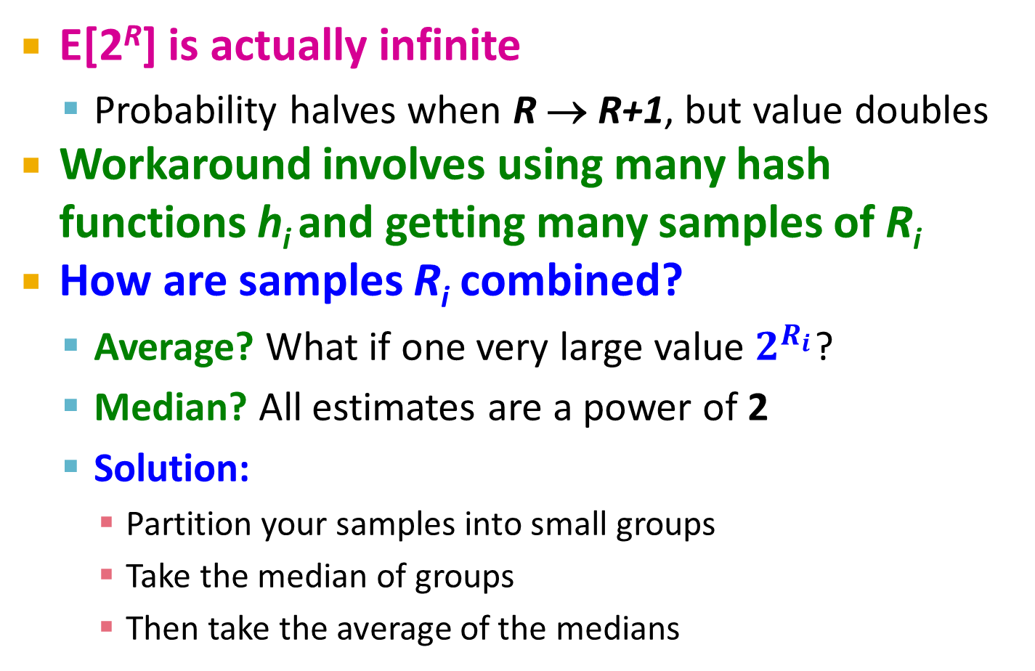
Why It Doesn’t Work
E[2^{R}] is actually infinite
Probability halves when R → R+1, but value doubles
Workaround involves using many hash functions h_{i} and getting many samples of R_{i}
How are samples R_{i} combined?
Average? What if one very large value $2^{R_{i}}$?
Median? All estimates are a power of 2
Solution:
Partition your samples into small groups
Take the median of groups
Then take the average of the medians

Slide 26
(3) Computing Moments

Slide 27
Generalization: Moments
Suppose a stream has elements chosen from a set A of N values
Let m_{i} be the number of times value i occurs in the stream
The k^{th} moment is

Slide 28
Special Cases
0thmoment = number of distinct elements
The problem just considered
1st moment = count of the numbers of elements = length of the stream
Easy to compute
2nd moment = surprise number S = a measure of how uneven the distribution is

Slide 29
Example: Surprise Number
Stream of length 100
11 distinct values
Item counts: 10, 9, 9, 9, 9, 9, 9, 9, 9, 9, 9 Surprise S = 910
Item counts: 90, 1, 1, 1, 1, 1, 1, 1 ,1, 1, 1 Surprise S = 8,110

Slide 30
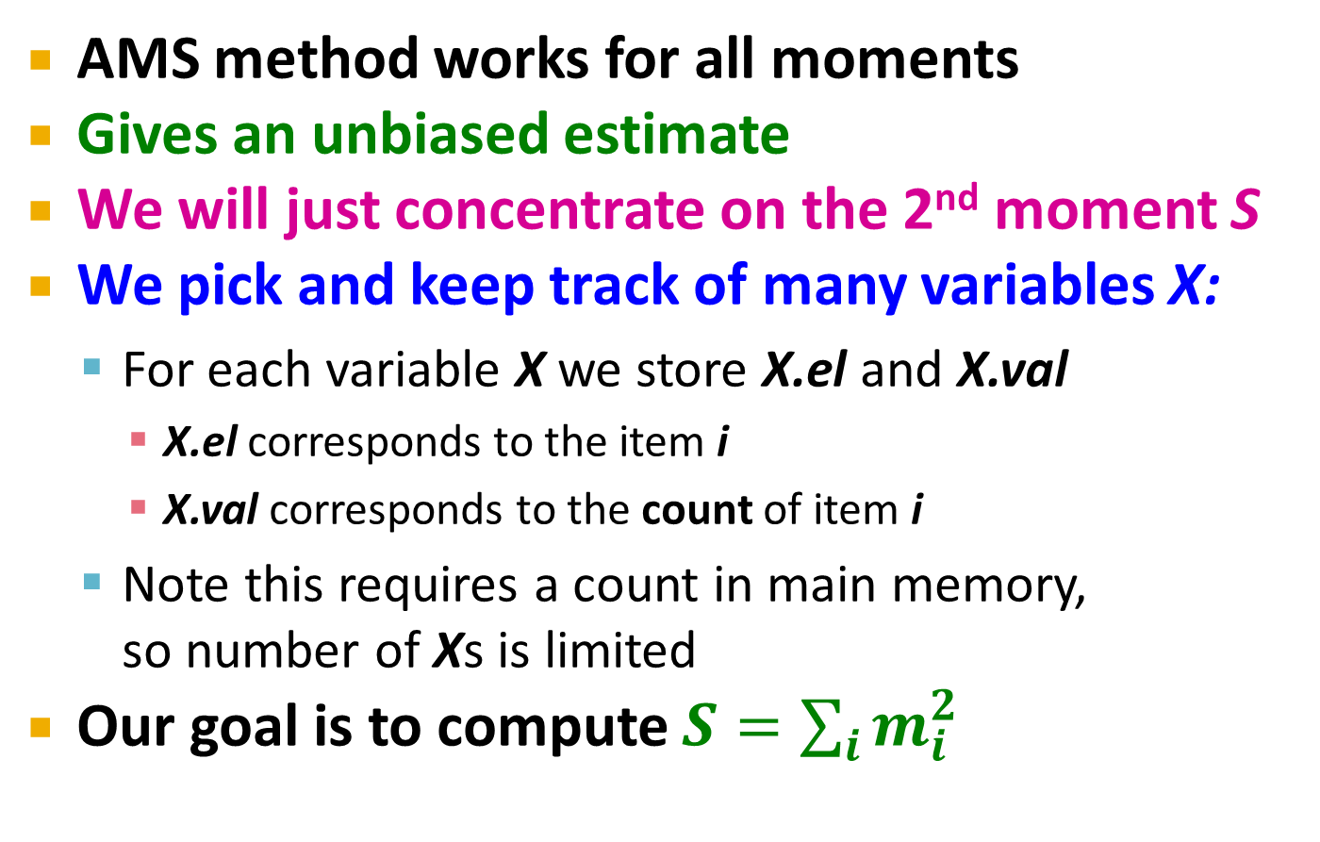
AMS Method
[Alon, Matias, and Szegedy]
AMS method works for all moments
Gives an unbiased estimate
We will just concentrate on the 2nd moment S
We pick and keep track of many variables X:
For each variable X we store X.el and X.val
X.el corresponds to the item i
X.val corresponds to the count of item i
Note this requires a count in main memory, so number of Xs is limited
Our goal is to compute $S=\sum_{i}{m_{i}^{2}}$

Slide 31
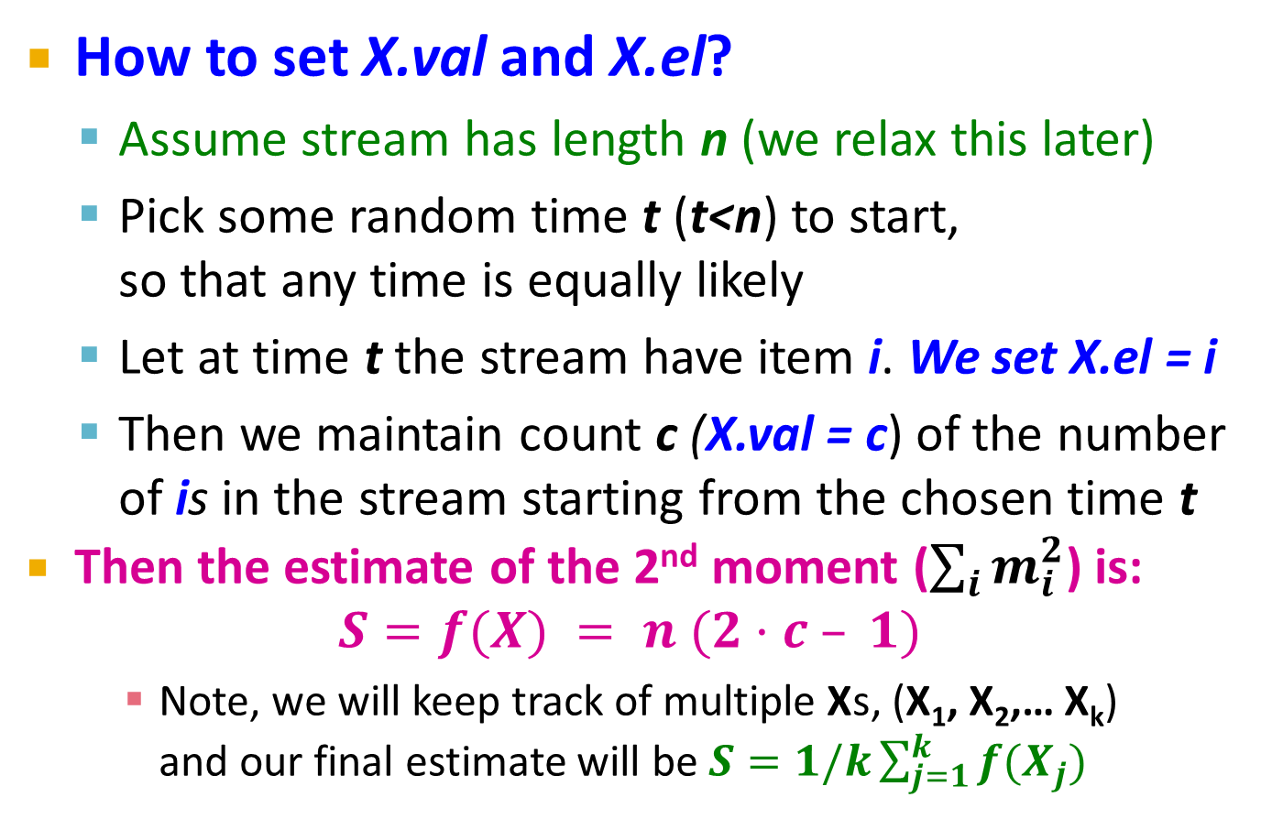
One Random Variable (X)
How to set X.val and X.el?
Assume stream has length n (we relax this later)
Pick some random time t (t<n) to start, so that any time is equally likely
Let at time t the stream have item i. We set X.el = i
Then we maintain count c (X.val = c) of the number of is in the stream starting from the chosen time t
Then the estimate of the 2nd moment ($\sum_{i}{m_{i}^{2}}$) is: $S=f(X) = n (2·c – 1)$
Note, we will keep track of multiple Xs, (X₁, X₂,… X_{k}) and our final estimate will be $S=1/k\sum_{j=1}^{k}{f(X_{j})}$

Slide 32
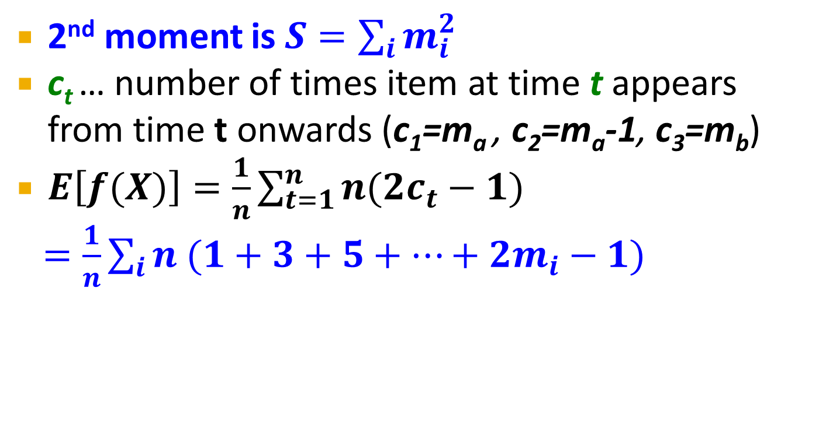
Expectation Analysis
Count:
1
2
3
m_{a}
Stream:
a
a
b
b
b
a
b
a
2nd moment is $S=\sum_{i}{m_{i}^{2}}$
c_{t} … number of times item at time t appears from time t onwards (c₁=m_{a} , c₂=m_{a}-1, c₃=m_{b})
$E\left[f(X)\right]=\frac{1}{n}\sum_{t=1}^{n}{n(2c_{t}−1)}$
$=\frac{1}{n}\sum_{i}{n (1+3+5+…+2m_{i}−1)}$
m_{i} … total count of item i in the stream (we are assuming stream has length n)
Time t when
the penultimate
i is seen (c_{t}=2)
Time t when
the first i is seen (c_{t}=m_{i})
Group times
by the value
seen
Time t when
the last i is seen (c_{t}=1)

Slide 33
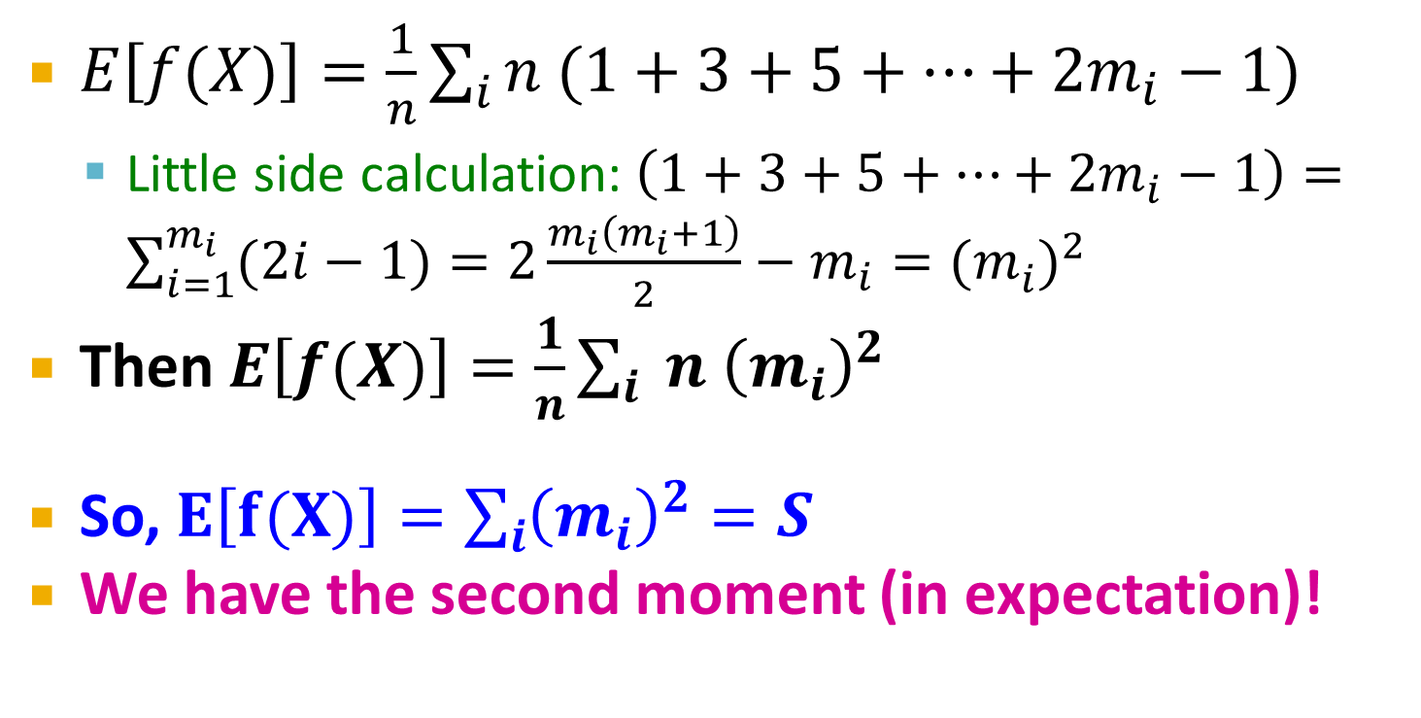
Expectation Analysis
Count:
1
2
3
m_{a}
Stream:
a
a
b
b
b
a
b
a
$E\left[f(X)\right]=\frac{1}{n}\sum_{i}{n (1+3+5+…+2m_{i}−1)}$
Little side calculation:$\left(1+3+5+…+2m_{i}−1\right)=\sum_{i=1}^{m_{i}}{(2i−1)}=2\frac{m_{i}\left(m_{i}+1\right)}{2}−m_{i}={(m_{i}^{})}^{2}$
Then $E\left[f(X)\right]=\frac{1}{n}\sum_{i}{ n {\left(m_{i}\right)}^{2}}$
So, $E\left[f(X)\right]=\sum_{i}{{\left(m_{i}\right)}^{2}}=S$
We have the second moment (in expectation)!

Slide 34
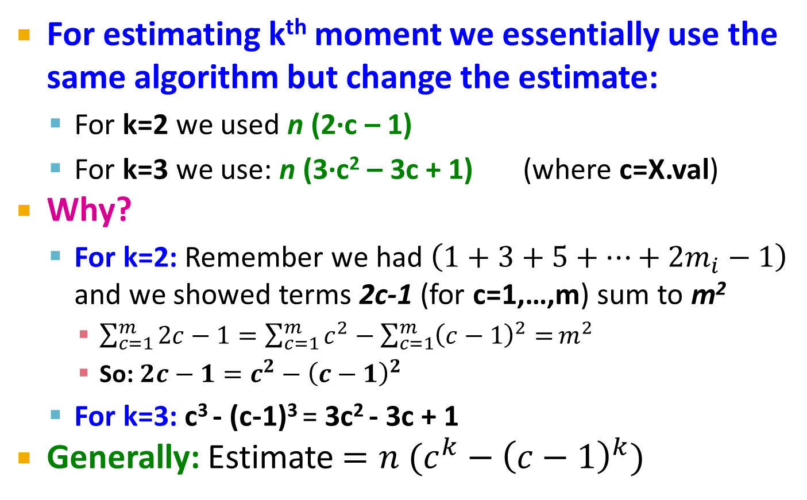
Higher-Order Moments
For estimating k^{th} moment we essentially use the same algorithm but change the estimate:
For k=2 we used n (2·c – 1)
For k=3 we use: n (3·c² – 3c + 1) (where c=X.val)
Why?
For k=2: Remember we had $\left(1+3+5+…+2m_{i}−1\right)$ and we showed terms 2c-1 (for c=1,…,m) sum to m²
$\sum_{c=1}^{m}{2c−1}=\sum_{c=1}^{m}{c^{2}}−\sum_{c=1}^{m}{{\left(c−1\right)}^{2}=}m^{2}$
So: $2c−1=c^{2}−{\left(c−1\right)}^{2}$
For k=3: c³ - (c-1)³ = 3c² - 3c + 1
Generally: Estimate $={n (c}^{k}−{\left(c−1\right)}^{k})$

Slide 35
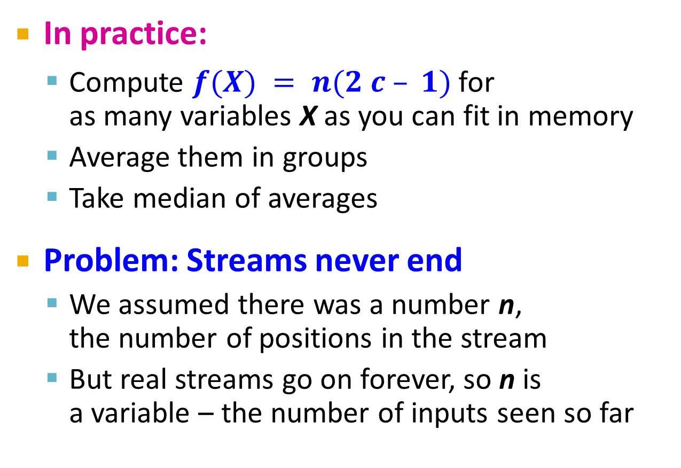
Combining Samples
In practice:
Compute $f(X) = n(2 c – 1)$for as many variables X as you can fit in memory
Average them in groups
Take median of averages
Problem: Streams never end
We assumed there was a number n, the number of positions in the stream
But real streams go on forever, so n is a variable – the number of inputs seen so far

Slide 36
Streams Never End: Fixups
(1) The variables X have n as a factor – keep n separately; just hold the count in X
(2) Suppose we can only store k counts. We must throw some Xs out as time goes on:
Objective: Each starting time t is selected with probability k/n
Solution: (fixed-size sampling!)
Choose the first k times for k variables
When the n^{th} element arrives (n > k), choose it with probability k/n
If you choose it, throw one of the previously stored variables X out, with equal probability

Slide 37
Counting Itemsets

Slide 38
Counting Itemsets
New Problem: Given a stream, which items appear more than s times in the window?
Possible solution: Think of the stream of baskets as one binary stream per item
1 = item present; 0 = not present
Use DGIM to estimate counts of 1s for all items
6
10
4
3
2
2
1
1
0
0 1 0 0 1 1 1 0 0 0 1 0 1 0 0 1 0 0 0 1 0 1 1 0 1 1 0 1 1 1 0 0 1 0 1 0 1 1 0 0 1 1 0 1 0
N

Slide 39
Extensions
In principle, you could count frequent pairs or even larger sets the same way
One stream per itemset
Drawbacks:
Only approximate
Number of itemsets is way too big

Slide 40
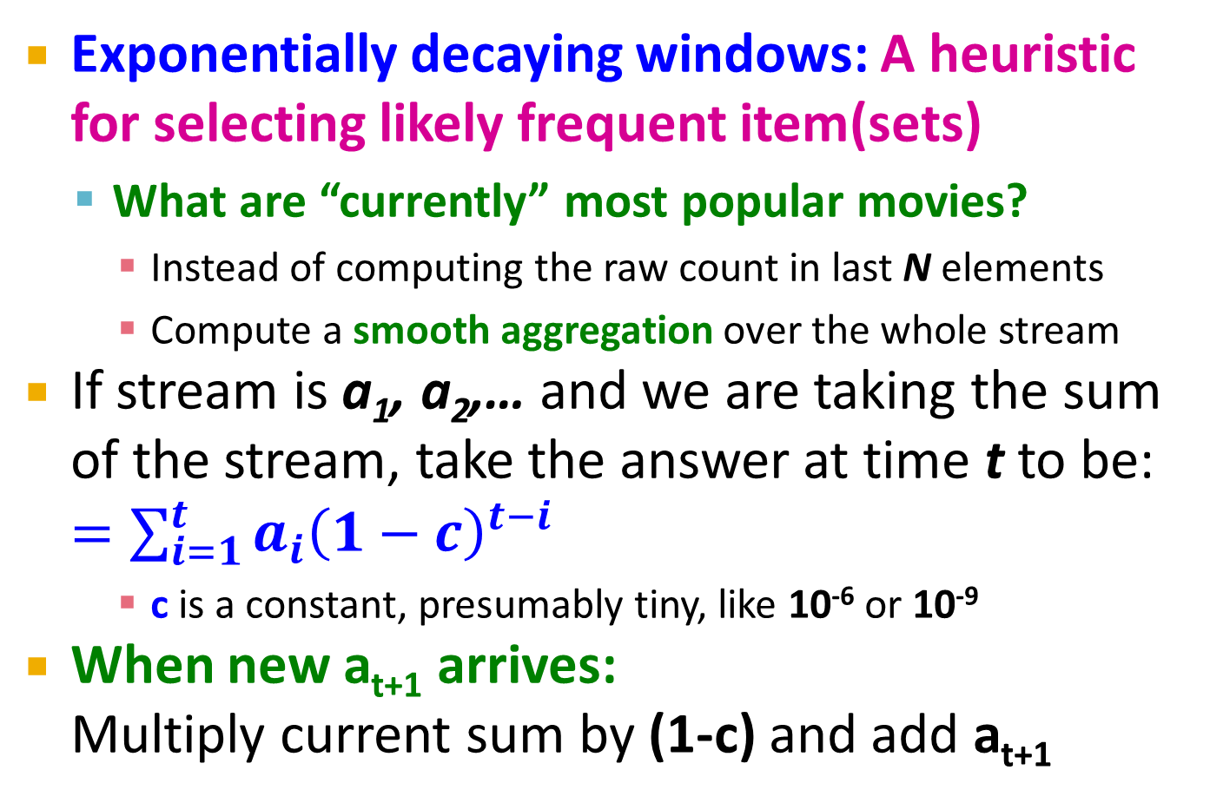
Exponentially Decaying Windows
Exponentially decaying windows: A heuristic for selecting likely frequent item(sets)
What are “currently” most popular movies?
Instead of computing the raw count in last N elements
Compute a smooth aggregation over the whole stream
If stream is a₁, a₂,… and we are taking the sum of the stream, take the answer at time t to be: $=\sum_{i=1}^{t}{a_{i}{\left(1−c\right)}^{t−i}}$
c is a constant, presumably tiny, like 10⁻⁶ or 10⁻⁹
When new a_{t+1} arrives: Multiply current sum by (1-c) and add a_{t+1}

Slide 41
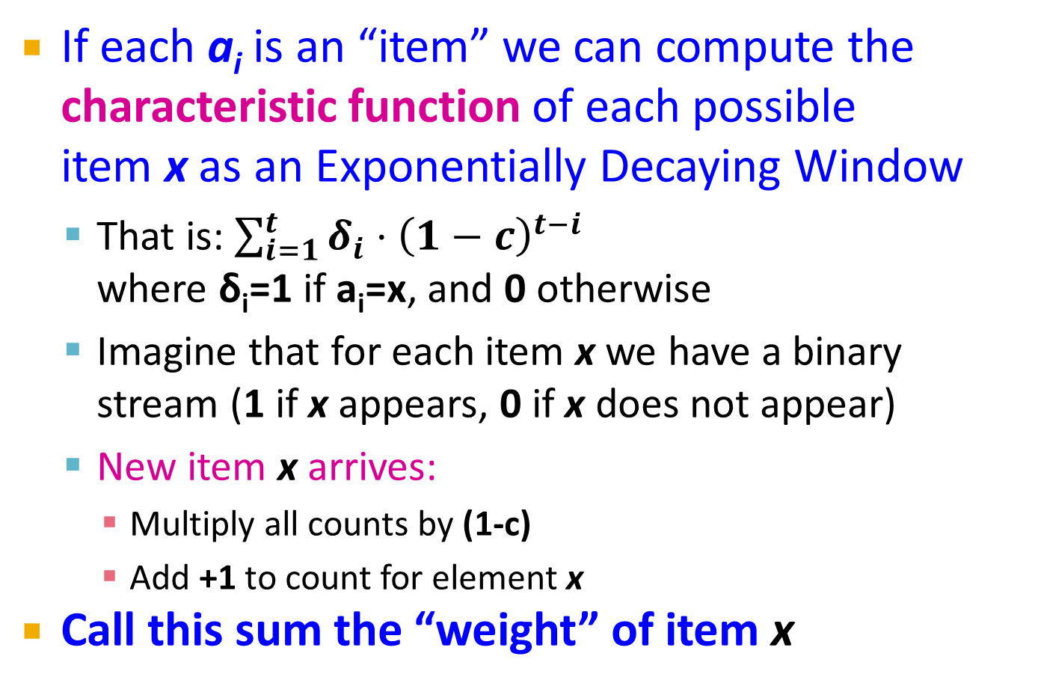
Example: Counting Items
If each a_{i} is an “item” we can compute the characteristic function of each possible item x as an Exponentially Decaying Window
That is: $\sum_{i=1}^{t}{δ_{i}{⋅\left(1−c\right)}^{t−i}}$ where δ_{i}=1 if a_{i}=x, and 0 otherwise
Imagine that for each item x we have a binary stream (1 if x appears, 0 if x does not appear)
New item x arrives:
Multiply all counts by (1-c)
Add +1 to count for element x
Call this sum the “weight” of item x

Slide 42
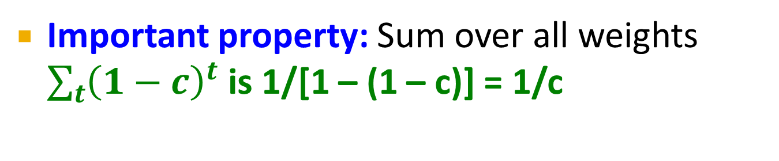
Sliding Versus Decaying Windows
. . .
1/c
Important property: Sum over all weights $\sum_{t}{{\left(1−c\right)}^{t}}$ is 1/[1 – (1 – c)] = 1/c

Slide 43
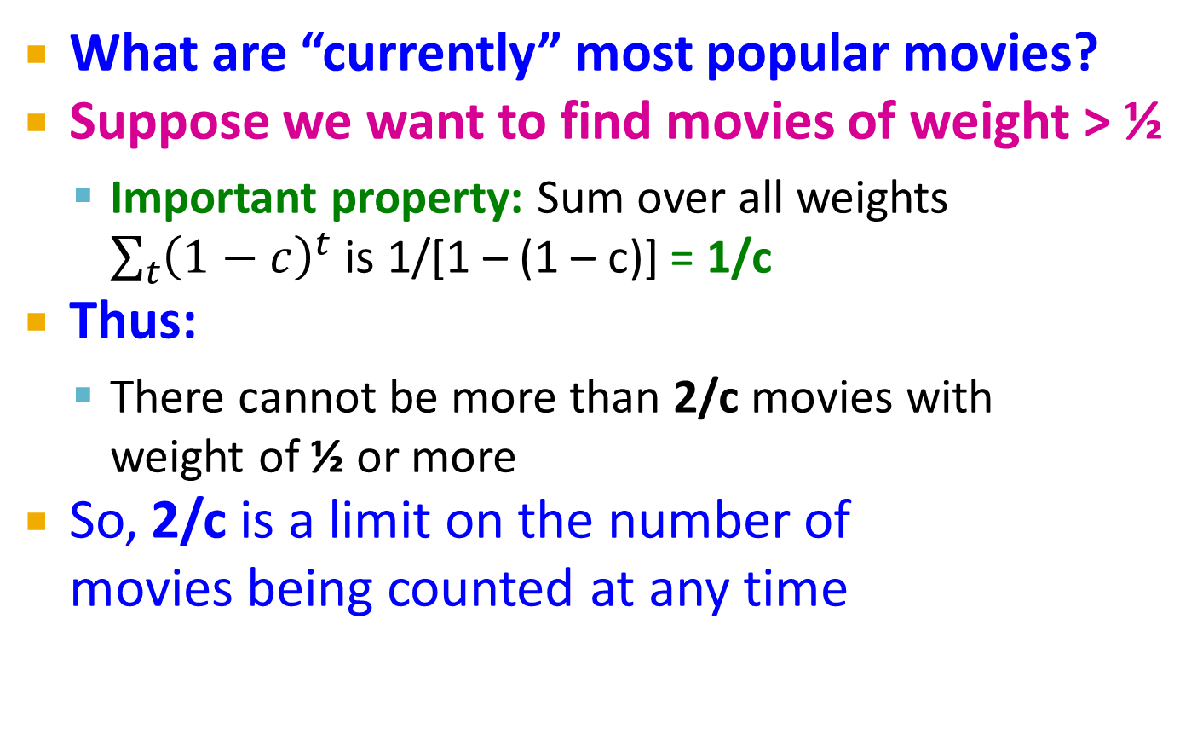
Example: Counting Items
What are “currently” most popular movies?
Suppose we want to find movies of weight > ½
Important property: Sum over all weights $\sum_{t}{{\left(1−c\right)}^{t}}$ is 1/[1 – (1 – c)] = 1/c
Thus:
There cannot be more than 2/c movies with weight of ½ or more
So, 2/c is a limit on the number of movies being counted at any time

Slide 44
Extension to Itemsets
Count (some) itemsets in an E.D.W.
What are currently “hot” itemsets?
Problem: Too many itemsets to keep counts of all of them in memory
When a basket B comes in:
Multiply all counts by (1-c)
For uncounted items in B, create new count
Add 1 to count of any item in B and to any itemset contained in B that is already being counted
Drop counts < ½
Initiate new counts (next slide)

Slide 45
Initiation of New Counts
Start a count for an itemset S ⊆ B if every proper subset of S had a count prior to arrival of basket B
Intuitively: If all subsets of S are being counted this means they are “frequent/hot” and thus S has a potential to be “hot”
Example:
Start counting S={i, j} iff both i and j were counted prior to seeing B
Start counting S={i, j, k} iff {i, j}, {i, k}, and {j, k} were all counted prior to seeing B

Slide 46
How many counts do we need?
Counts for single items < (2/c)∙(avg. number of items in a basket)
Counts for larger itemsets = ??
But we are conservative about starting counts of large sets
If we counted every set we saw, one basket of 20 items would initiate 1M counts

